Slide 1
Vibe Coding: The New No- Code Practice for Business Builders
Week 10 Ed Elowson

Slide 2
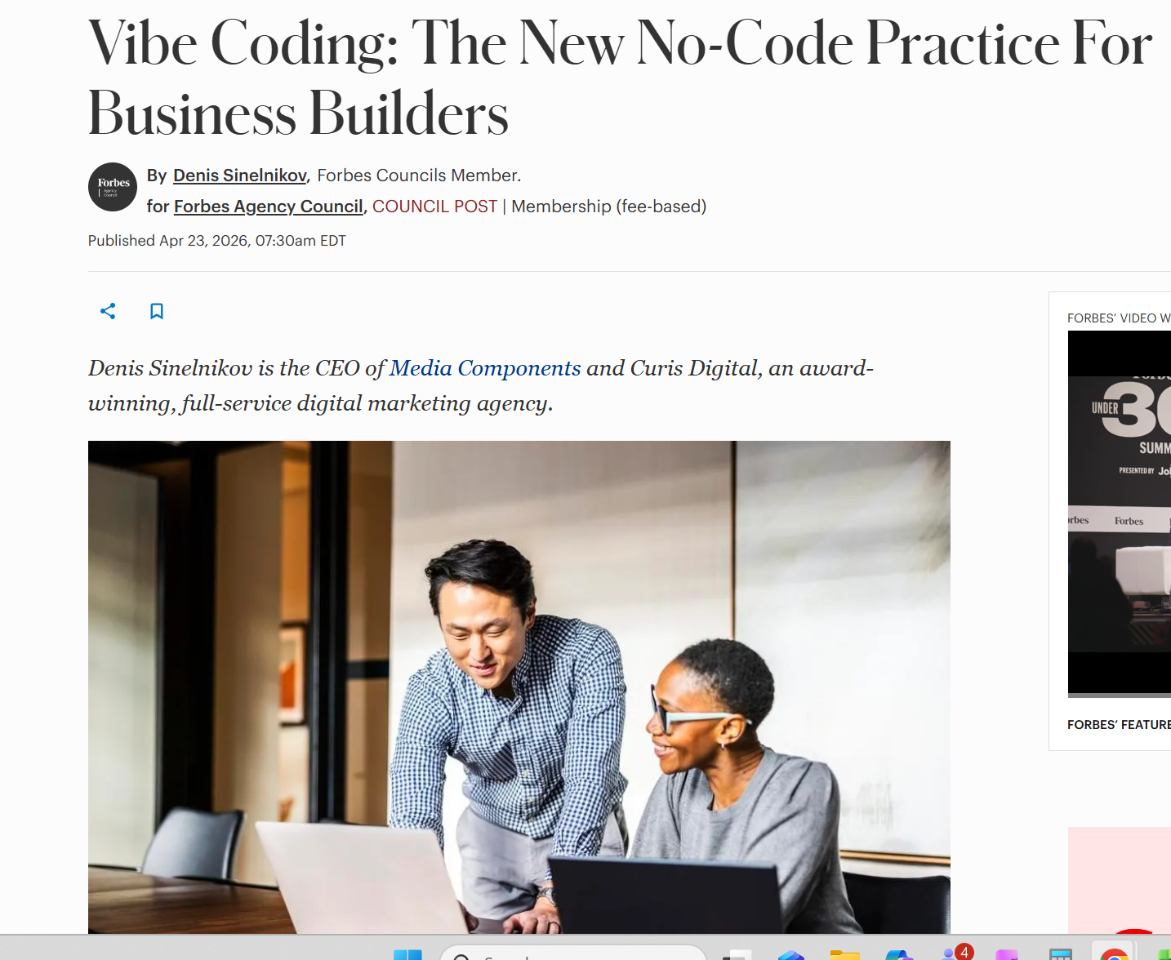
Screenshot

Slide 3
Link To The Source
https://www.forbes.com/councils/forbesagencycouncil/2026/04/23/vibe-coding-the-new-no-code-practice-for-business-builders/

Slide 4
Main Findings
1. Main Findings and Arguments
AI is shifting software development from coding to orchestration
The article argues that “vibe coding” is not simply amateur experimentation anymore—it is becoming a legitimate enterprise software development model. Instead of manually writing every line of code, developers increasingly guide AI systems through prompts, review outputs, and refine results.
The core argument is that:
AI is becoming a software co-creator rather than just a coding assistant.
Engineers are transitioning from “builders of code” to “supervisors of systems.”
Speed of development is increasing dramatically.
Examples from the article include:
Vanguard reducing webpage prototyping from two weeks to 20 minutes.
AI already generating 20%+ of code at companies like Google and Microsoft.
Gartner predicting 40% of new enterprise software will involve AI-generated code within three years.

Slide 5
Main Findings
Governance and security are becoming critical concerns
Another key argument is that AI-generated software creates organizational risk if unmanaged.
Executives fear:
“shadow IT,”
insecure applications,
privacy violations,
undocumented workflows,
and uncontrolled software creation by nontechnical employees.
The article frames governance as one of the defining enterprise challenges of vibe coding adoption.
The role of engineers is changing—not disappearing
A major theme is that software engineers are still essential, but their responsibilities are evolving.
The article repeatedly emphasizes:
Engineers must define constraints and guardrails.
Humans remain responsible for validation, QA, security, and system integration.
AI-generated code still requires professional oversight.
The future engineer described in the article is less focused on syntax and more focused on:
business logic,
systems thinking,
validation,
governance,
and problem-solving.

Slide 6
Broader Implications
Software Creation Is Becoming Democratized
Software development is no longer limited to trained programmers.
Employees in marketing, HR, operations, finance, design, and logistics may soon create functional applications using natural language prompts.
Potential outcomes:
Faster innovation cycles
Lower barriers to entrepreneurship
Reduced dependence on traditional software teams
Domain experts building solutions directly

Slide 7
Broader Implications
Comparable Historical Shifts
Spreadsheets democratized finance
Websites democratized publishing
Smartphones democratized media creation
Vibe coding may democratize software creation itself

Slide 8
Broader Implications
Knowledge Work May Become More AI-Mediated
Future work may increasingly involve:
Directing AI systems
Validating outputs
Integrating tools and workflows
Coordinating across technical and nontechnical teams
Workforce Transformation
Fewer repetitive technical tasks
Greater emphasis on judgment and systems thinking
More interdisciplinary collaboration
Blurring distinction between “technical” and “nontechnical” roles

Slide 9
Broader Implications
Economic and Governance Implications
Productivity Gains Could Reshape the Workforce
AI-assisted development may dramatically increase efficiency:
Prototyping reduced from weeks to minutes
AI generating large portions of software code
Fewer workflow handoffs between teams
Potential Organizational Effects
Smaller or flatter technical teams
Reduced demand for junior execution-focused roles
Greater demand for adaptable, strategic workers
Resulting Tension
Significant economic opportunity
Increased workforce disruption risk

Slide 10
Broader Implications
Governance and Trust Become Critical Challenges
AI-generated systems may scale faster than organizations can govern them.
Emerging Risks
Cybersecurity vulnerabilities
Privacy concerns
Reliability and quality assurance issues
Accountability gaps
Regulatory and compliance challenges
Long-Term Societal Concern
Organizations and society may increasingly depend on AI-generated systems whose underlying logic is difficult for humans to fully understand.

Slide 11
Relevance and Potential Influence on the Construction Industry
This article is extremely relevant to construction, even though construction is not directly discussed.
Construction is one of the industries most likely to benefit from vibe coding because it suffers from:
fragmented workflows,
massive documentation burdens,
disconnected software systems,
and chronic shortages of technical talent.

Slide 12
Relevance and Potential Influence on the Construction Industry
Construction teams could build their own operational tools
Project managers, superintendents, estimators, and facilities teams may soon create:
RFI trackers,
punch list systems,
submittal dashboards,
safety reporting apps,
labor tracking tools,
QA/QC workflows,
equipment maintenance systems,
and BIM data viewers
without waiting months for IT or external software vendors.

Slide 13
Relevance and Potential Influence on the Construction Industry
This is potentially transformative because construction software development has historically been:
slow,
expensive,
highly customized,
and poorly aligned with field operations.
Vibe coding enables domain experts—the people who actually understand the workflows—to directly participate in software creation.

Slide 14
Relevance and Potential Influence on the Construction Industry
AI may become the “middleware” of construction operations
Construction firms often operate across dozens of disconnected systems:
Procore,
Autodesk,
Bluebeam,
CMMS systems,
ERP platforms,
spreadsheets,
PDFs,
email chains,
and field documentation apps.

Slide 15
Relevance and Potential Influence on the Construction Industry
The industry may shift from buying software to composing workflows
Historically, construction firms purchased large monolithic platforms.
The article points toward a future where firms instead:
assemble modular workflows,
generate custom interfaces,
automate specific operational bottlenecks,
and continuously adapt systems internally.
That aligns closely with how construction actually works:
every project is different,
workflows constantly change,
and rigid software often fails in the field.

Slide 16
Relevance and Potential Influence on the Construction Industry
The role of construction technologists may fundamentally change
The article’s description of software engineers becoming validators rather than pure coders maps directly onto construction technology roles.
Future construction technologists may spend less time:
building software manually,
and more time:
orchestrating AI systems,
validating workflows,
governing data integrity,
integrating platforms,
and translating field operations into AI-readable processes.
This could elevate the importance of hybrid professionals who understand both:
construction operations,
and AI/system architecture.
That hybrid skill set may become one of the most valuable roles in the industry over the next decade.

Slide 17
